Slide 1
Why Quality Matters in ART Programs
Charles B. Holmes, MD, MPH
Georgetown University Center for Global Health Practice and Impact &
Johns Hopkins School of Medicine
#IAS2019 Satellite: Addressing the quality gap within HIV programmes

Slide 2
Outline
How is impact achieved?
Elements of quality HIV services
New WHO Quality Technical Brief
Ensuring care is people-centered- measuring the patient experience
The link between quality care and drug resistance
Conclusions

Slide 3
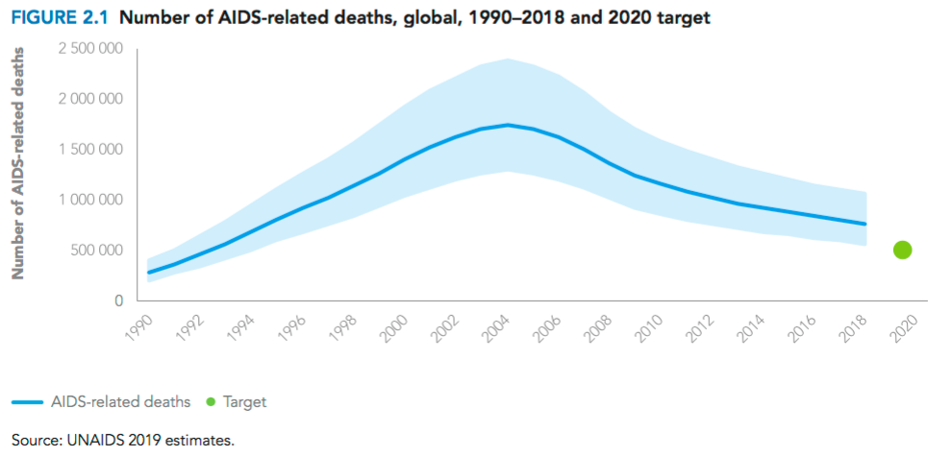
When you look at this curve, what comes to mind?
UNAIDS, 2018

Slide 4
What comes to mind?
Clinical Quality?
UNAIDS, 2018

Slide 5
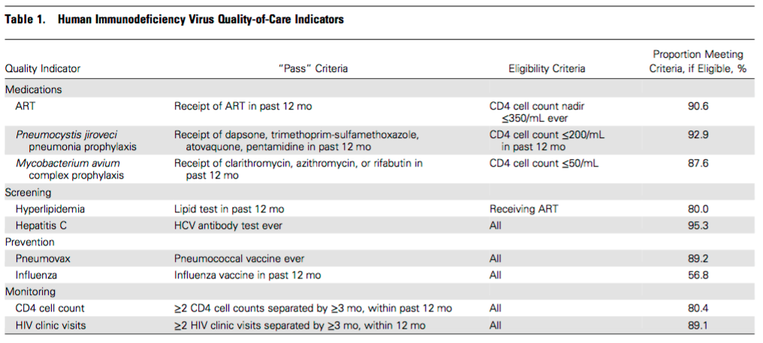
Quality care and mortality
Longitudinal survival analysis of the (US) Veterans Aging Cohort Study included 3038 people living with HIV
Korthuis et al, CID 2016

Slide 6
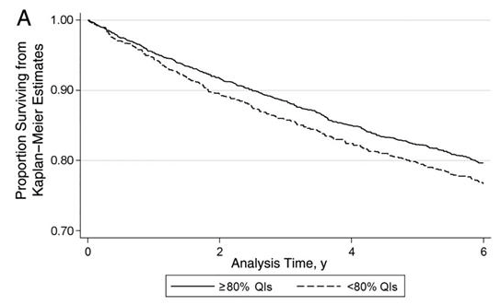
Quality indicators associated w/decreased mortality
Overall, receiving ≥80% of eligible QIs was associated with a 25% decrease in mortality rate compared with receiving a lower percentage of eligible QIs (age-adjusted hazards ratio, 0.75; 95% confidence interval, .65–.86).
Korthuis et al, CID 2016

Slide 7
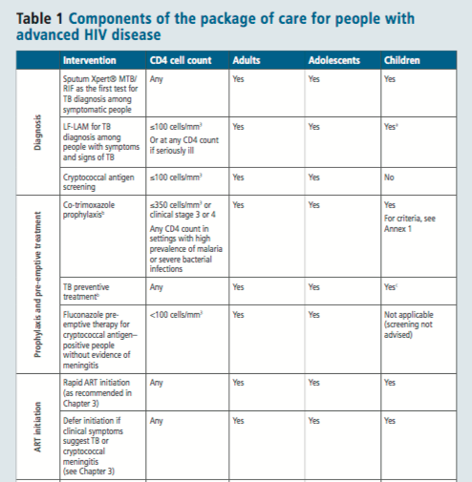
WHO advanced care guidelines
For adults, adolescents, and children ≥ 5 years, advanced HIV disease is defined as a CD4 cell count <200 cells/mm3 or a WHO clinical stage 3 or 4 event at presentation for care
Estimates of eligibility in LMIC for the advanced care package range from 15-30% depending on the setting

Slide 8
Quality of care for patients with advanced disease?
Show of hands for current coverage of advanced disease package in LMIC:
10%
46%
81%
The Answer?
We don’t know

Slide 9
Access x Quality = Impact

Slide 10
Access?
Is our treatment scale-up slowing down?

Slide 11
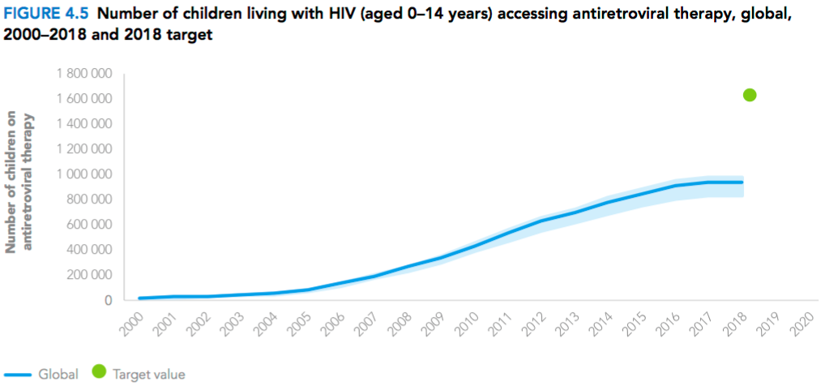
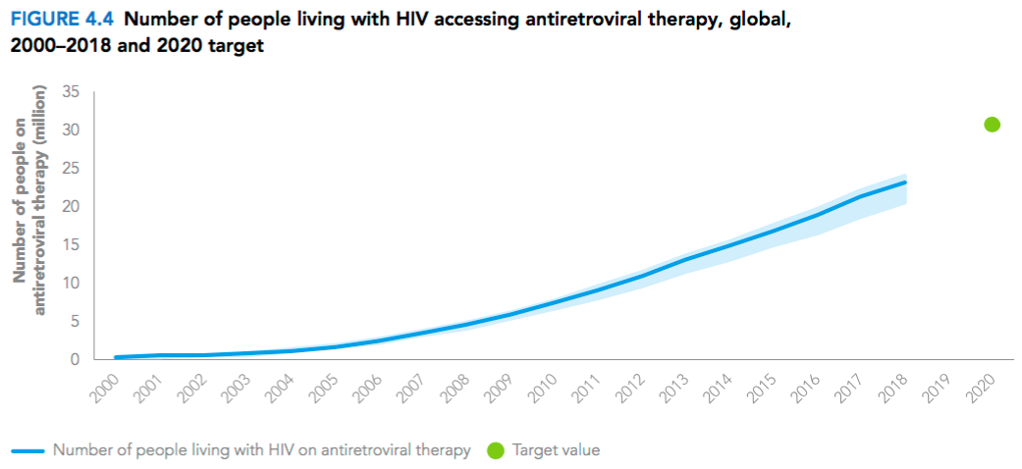
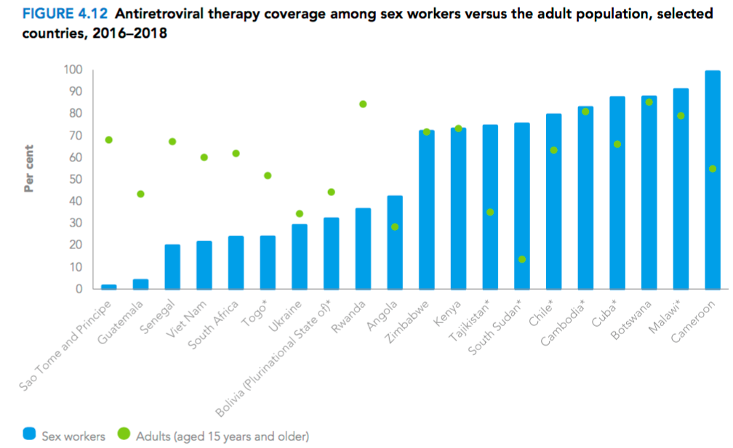
Access?
But maybe we’re differentially missing sub-groups with higher mortality
Treatment scale-up is continuing apace
Children
Sex workers
UNAIDS, 2019
Notes:
Conceivable that poor access among people at highest risk for mortality…

Slide 12
Upstream quality affects downstream access
If we’re differentially “missing” individuals at high risk for mortality, we have an upstream quality problem
It could be that existing testing programs are settling for numbers or yield, but not effectively reaching the highest risk individuals (a quality issue in testing program)
It could also be that the services for FSW or for children are insufficiently person-centered and do not retain people in care (a quality issue in the care delivery program)
From a public health perspective, ACCESS at any step of the cascade is a partly a function of upstream QUALITY and ACCESS

Slide 13
Access x Quality = Impact

Slide 14
Upstream quality affects access and impact
Prevention
Access x quality
Testing
Better upstream quality in testing programs (e.g., not overlooking those at greatest risk for mortality - or transmission)…
Access x quality
Linkage and treatment initiation
Access x quality
Advanced care package
And so on throughout the cascade
Access x quality
Retention
Access x quality
…results in greater access to/utilization of HIV care and treatment
Virological suppression
Access x quality
Quality upstream in the public health cascade contributes to later access to service
= Impact

Slide 15
Mortality due to poor quality versus non-utilisation of health care by condition type
5 million ‘excess’ deaths due to poor quality care in LMIC in 2016
Kruk et al, Lancet 2018

Slide 16
What do quality HIV services look like?

Slide 17
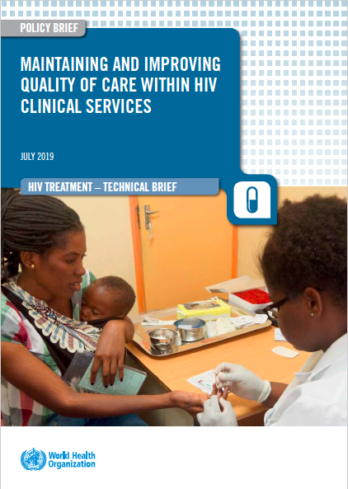
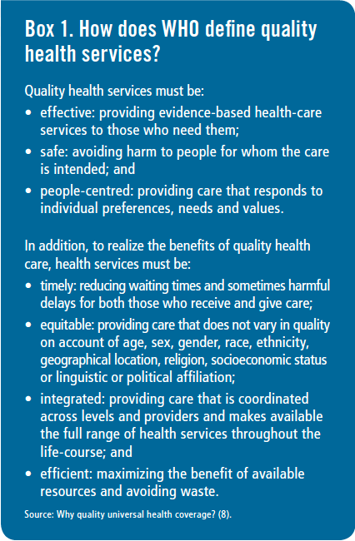
WHO Technical Brief on Quality of HIV Care, 2019

Slide 18
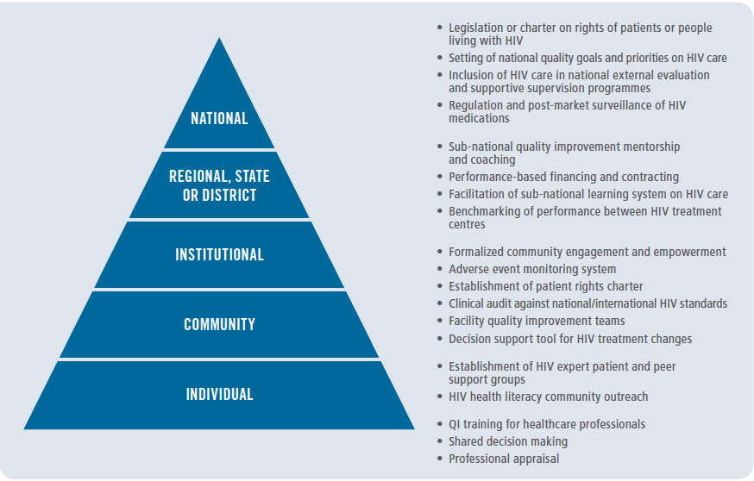
“Quality HIV services span not only clinical, but health systems and other service delivery components and settings across cascades of HIV prevention, care and treatment services as well as maternal, newborn and child health.”
WHO Technical Brief on Quality of HIV Care, 2019

Slide 19
WHO: Enablers of Quality HIV Services

Slide 20
How do we ensure delivery of people-centered quality health services?

Slide 21
“Health systems should measure and report what matters most to people, such as competent care, user experience, health outcomes, and confidence in the system”
- Lancet Commission on Quality Health Systems
Kruk et al, Lancet 2018

Slide 22
Understanding patient preferences is an important part of ensuring people-centered care &quality service delivery
This can be done broadly, or among enriched sub-sets of patients
Study conducted in Zambia to better understand the health systems preferences of those who had disengaged from care - with the goal of adjusting elements of the health system to better accommodate their needs and improve quality
Sought a random sample of HIV patients who were lost to follow-up from treatment facilities in Lusaka Province, Zambia.
Zanolini, PLOS Med 2018

Slide 23
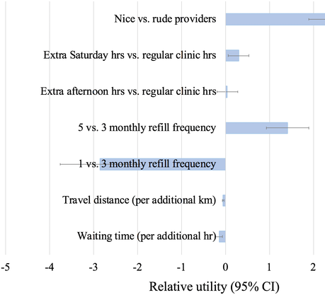
Preferences for HIV care among the lost
Survey offered to 385 LTFU individuals, and 280 participated (average age 35; 60% females)
Willingness to wait analysis suggested that patients would trade up to 19 hours of waiting time to access a facility with nice as opposed to rude providers.
A willingness to travel analysis suggested that patients were willing to travel an extra 45 km to see a nice as opposed to a rude provider
Zanolini, PLOS Med 2018

Slide 24
How can we improve the patient experience and health outcomes?
“In addition to current improvement efforts to increase drug dispensation, move services closer to home, and extend hours (through DSD models), a concomitant effort to improve healthcare worker attitude has not been undertaken but may represent a high priority.”
Requires systematic measurement of patient experience, provider morale and satisfaction
Likely requires ongoing training and support for providers that enables them to enhance their practice of person-centered care, along with feedback of actionable data to site-and higher level decision-makers.
Ongoing Patient-Centered Public Health (PCPH) study in Zambia - a stepped wedge study testing these combined strategies
Zanolini, PLOS Med 2018

Slide 25
What’s the link between quality HIV services and prevention of drug resistance?
“Preventing HIV drug resistance is critical for the success of any HIV treatment programme and is achieved by optimizing the quality of antiretroviral therapy services and eliminating programmatic gaps along the cascade of HIV treatment.”

Slide 27
Conclusions
Quality upstream in the public health cascade helps to determine later access to service- quality is therefore an essential part of access and impact
National quality programs promote actions at all levels of the health system
Patient preferences/experience should be measured within HIV programs, and are essential to tailoring services to become more person-centered
Prevention of HIV drug resistance relies on quality delivery of health services (more to come from Sylvia)

